Slide 1
Convert
PDAs to
Context-Free Grammars
Proof - step 2
Fall 2006
Costas Busch - RPI

Slide 2


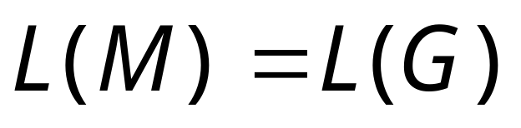
Take an arbitrary PDA
We will convert
to a context-free grammar such that:
Fall 2006
Costas Busch - RPI

Slide 3
Convert PDA to CFG
Simplification of PDA.
Build a grammar .
Fall 2006
Costas Busch - RPI

Slide 4
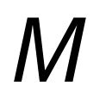
Simplification of PDA
First modify PDA so that:
1. The PDA has a single accept state
2. Use new initial stack symbol #
3. On acceptance the stack contains only
stack symbol #
4. Each transition either pushes a symbol
or pops a symbol but not both together
Fall 2006
Costas Busch - RPI

Slide 5
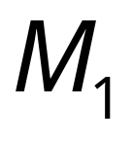
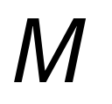
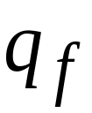
1. The PDA has a single accept state
PDA
Old
accept
states
New
accept
state
PDA
λ
,
λ
→
λ
λ
,
λ
→
λ
→
λ
λ
,
λ
Fall 2006
Costas Busch - RPI

Slide 6
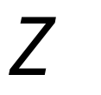


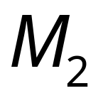
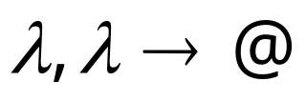
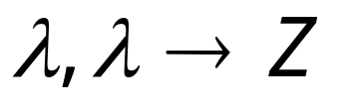
2. Use new initial stack symbol #
Top of stack
old initial stack symbol
auxiliary stack symbol
new initial stack symbol
PDA
PDA
still thinks that Z is the initial stack
Fall 2006
Costas Busch - RPI

Slide 7
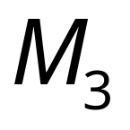


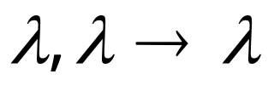
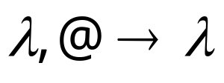
3. On acceptance the stack contains only
stack symbol #
PDA
Empty stack
Old
accept
state
New
accept
state
PDA
Fall 2006
Costas Busch - RPI

Slide 8
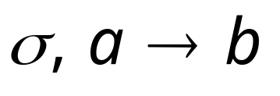


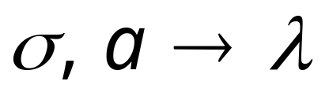
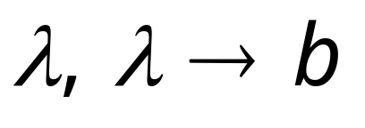
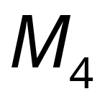
4. Each transition either pushes a symbol
or pops a symbol but not both together
PDA
PDA
Fall 2006
Costas Busch - RPI

Slide 9
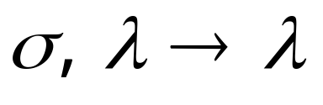
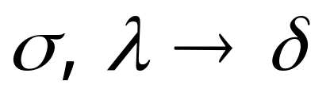
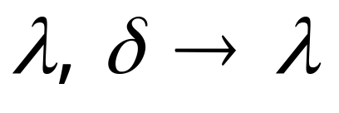
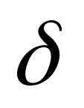
PDA
PDA
Where is a symbol of the stack alphabet
Fall 2006
Costas Busch - RPI

Slide 10
PDA is the final modified PDA
Note that the new initial stack symbol #
is never used in any transition
Fall 2006
Costas Busch - RPI

Slide 11
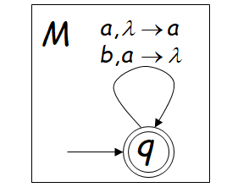
Fall 2006
Costas Busch - RPI

Slide 12
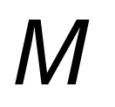

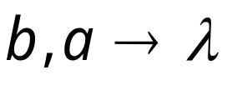

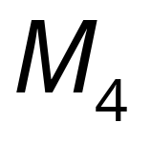

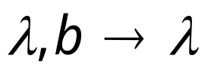

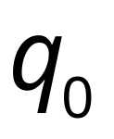

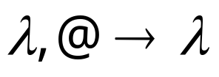
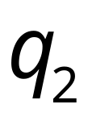
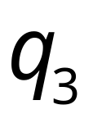
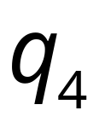
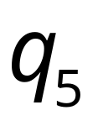
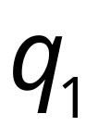

Example:
Fall 2006
Costas Busch - RPI

Slide 13
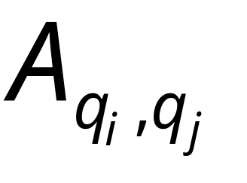
Grammar Construction
Variables:
States of PDA
Fall 2006
Costas Busch - RPI

Slide 14
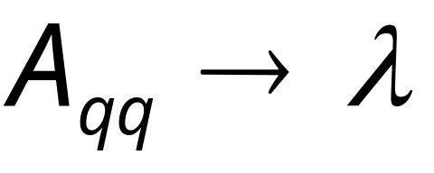
PDA
Kind 1: for each state
Grammar
Fall 2006
Costas Busch - RPI

Slide 15
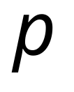

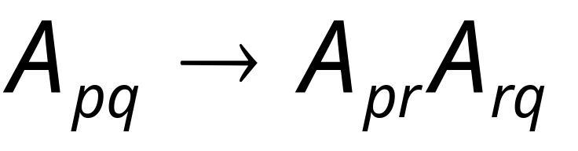
PDA
Kind 2: for every three states
Grammar
Fall 2006
Costas Busch - RPI

Slide 16
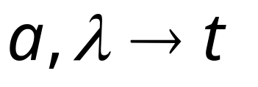
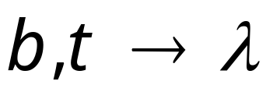

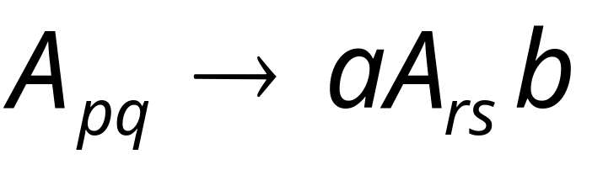
PDA
Kind 3: for every pair of such transitions
Grammar
Fall 2006
Costas Busch - RPI

Slide 17
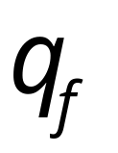
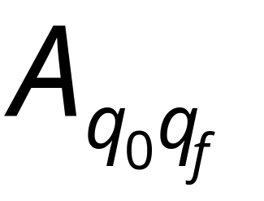
PDA
Initial state
Accept state
Grammar
Start variable
Fall 2006
Costas Busch - RPI

Slide 18
Example:
PDA
Fall 2006
Costas Busch - RPI

Slide 19
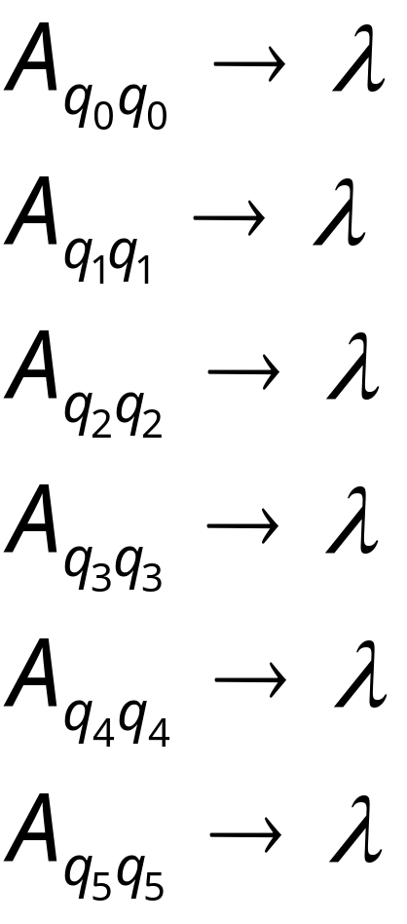
Grammar
Kind 1: from single states
Fall 2006
Costas Busch - RPI

Slide 20
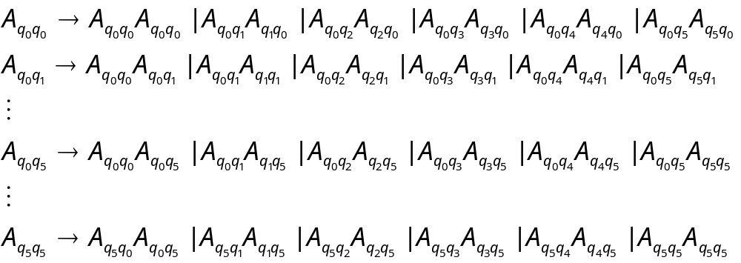
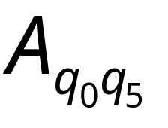
Kind 2: from triplets of states
Start variable
Fall 2006
Costas Busch - RPI

Slide 21
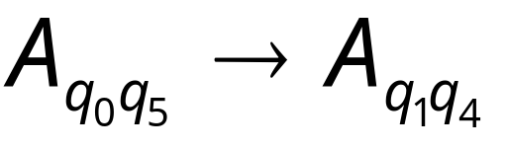
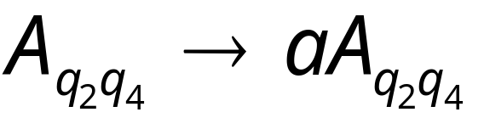
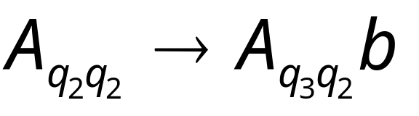
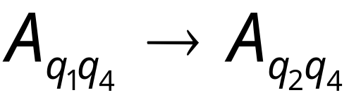
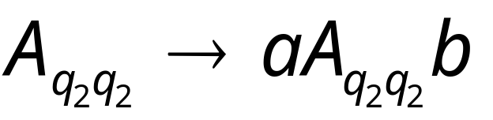
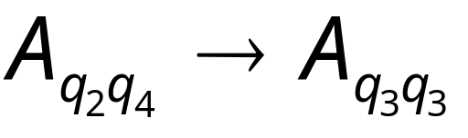


Kind 3: from pairs of transitions
Fall 2006
Costas Busch - RPI

Slide 22




Suppose that a PDA is converted
to a context-free grammar
We need to prove that
or equivalently
Fall 2006
Costas Busch - RPI

Slide 23



We need to show that if has derivation:
(string of terminals)
Then there is an accepting computation in :
with input string
Fall 2006
Costas Busch - RPI

Slide 24


We will actually show that if has derivation:
Then there is a computation in :
Fall 2006
Costas Busch - RPI

Slide 25

Therefore:
Since there is no transition
with the # symbol
Fall 2006
Costas Busch - RPI

Slide 26





Lemma:
If (string of terminals)
then there is a computation
from state to state on string
which leaves the stack empty:
Fall 2006
Costas Busch - RPI

Slide 27



Proof Intuition:
Type 2
Case 1:
Type 3
Case 2:
Fall 2006
Costas Busch - RPI

Slide 28





Type 2
Case 1:
Stack
height
Input string
Generated by
Generated by
Fall 2006
Costas Busch - RPI

Slide 29




Type 3
Case 2:
Stack
height
Input string
Generated by
Fall 2006
Costas Busch - RPI

Slide 30
Formal Proof:
We formally prove this claim
by induction on the number
of steps in derivation:
number of steps
Fall 2006
Costas Busch - RPI

Slide 31





Induction Basis:
(one derivation step)
A Kind 1 production must have been used:
Therefore, and
This computation of PDA trivially exists:
Fall 2006
Costas Busch - RPI

Slide 32

Induction Hypothesis:
derivation steps
suppose it holds:
Fall 2006
Costas Busch - RPI

Slide 33

Induction Step:
derivation steps
We have to show:
Fall 2006
Costas Busch - RPI

Slide 34
derivation steps
Type 2
Case 1:
Type 3
Case 2:
Fall 2006
Costas Busch - RPI

Slide 35




Type 2
Case 1:
steps
We can write
At most steps
At most steps
Fall 2006
Costas Busch - RPI

Slide 36


At most steps
At most steps
From induction
hypothesis, in PDA:
From induction
hypothesis, in PDA:
Fall 2006
Costas Busch - RPI

Slide 37


since
Fall 2006
Costas Busch - RPI

Slide 38


Type 3
Case 2:
steps
We can write
At most steps
Fall 2006
Costas Busch - RPI

Slide 39

At most steps
From induction hypothesis,
the PDA has computation:
Fall 2006
Costas Busch - RPI

Slide 40

Type 3
Grammar contains production
And PDA Contains transitions
Fall 2006
Costas Busch - RPI

Slide 41


Fall 2006
Costas Busch - RPI

Slide 42


We know
We also know
Therefore:
Fall 2006
Costas Busch - RPI

Slide 43

since
END OF PROOF
Fall 2006
Costas Busch - RPI

Slide 44



So far we have shown:
With a similar proof we can show
Therefore:
Fall 2006
Costas Busch - RPI

